Slide 1
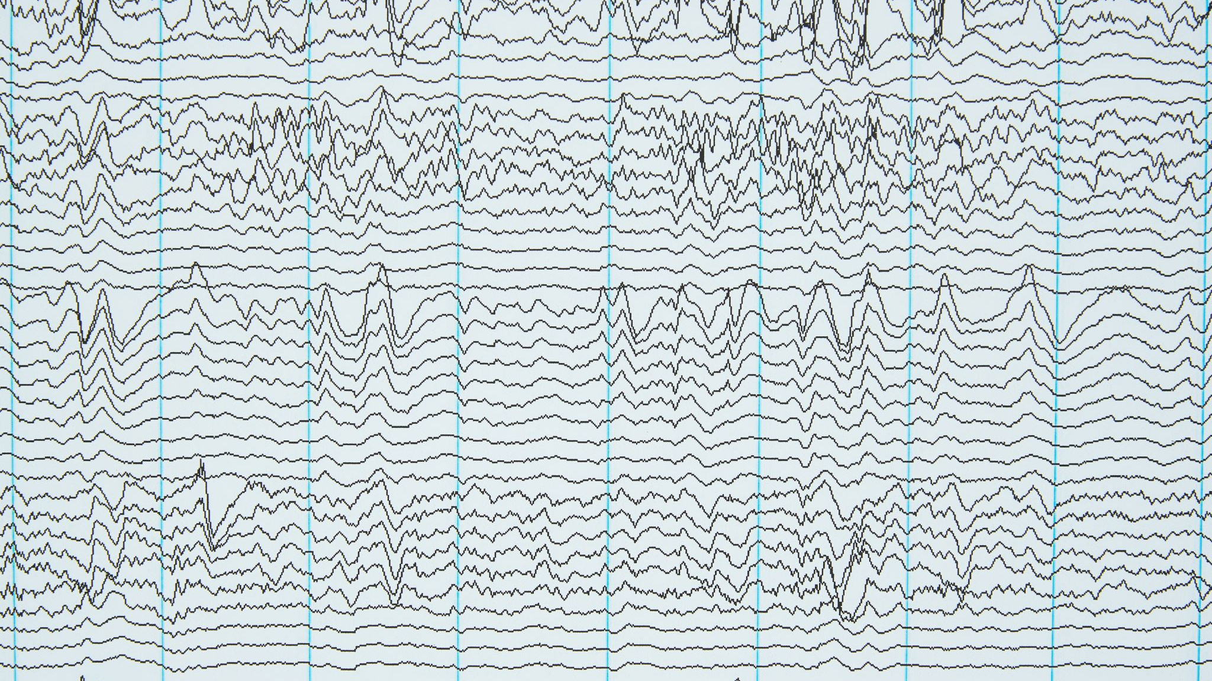
Resting state EEG alpha waves extraction and calculations of 1/slope using FOOOF library
Presented by Donata Bagdonavičiūtė

Slide 2
A little bit about data
37 women in early follicular faze of natural cycle.
Data were collected after emotion regulation task during resting state.
The main object of interest is alpha power, individual alpha and 1/f slope.
Notes:
Some participants are missing due to broad artefacts in EEG data.

Slide 3
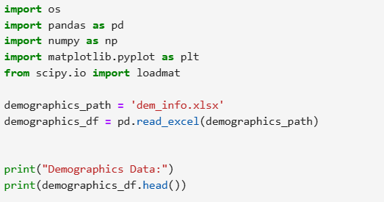
Demographics data
Notes:
os: Used for interacting with the operating system (e.g., working with file paths).
pandas: A powerful library for working with tabular data (Excel, CSV files, etc.).
numpy: Used for numerical operations, like arrays and mathematical calculations.
matplotlib.pyplot: A library for plotting and visualizing data.
scipy.io.loadmat: Allows reading .mat files (MATLAB files containing data).
pd.read_excel: Reads the Excel file dem_info.xlsx and loads it into a DataFrame.
head(): Displays the first few rows of the data.

Slide 4

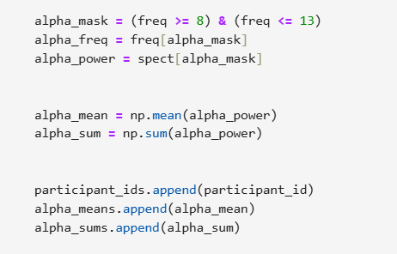
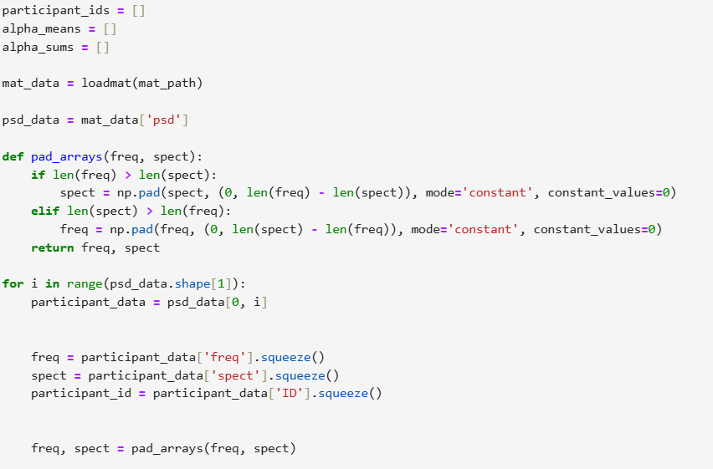
Alpha power extraction from .mat file
Notes:
Why?: The EEG power spectral density (PSD) data is stored in a MATLAB .mat file.What it does:loadmat: Loads the MATLAB file and stores the data in a Python dictionary.
psd_data: Accesses the 'psd' key inside the loaded MATLAB data, which contains EEG data.
participant_ids: To store participant IDs.
alpha_means: To store the mean power in the alpha band (8–13 Hz).
alpha_sums: To store the sum of power in the alpha band.
Why?: The alpha band (8–13 Hz) is the focus of analysis.
What it does:alpha_mask: A boolean array where True values indicate frequencies between 8 and 13 Hz.
alpha_freq: Extracts frequencies in the alpha range.
alpha_power: Extracts the power values corresponding to those frequencies.
Why?: To quantify the power in the alpha band.What it does:np.mean: Calculates the average (mean) power in the alpha band.
np.sum: Calculates the total (sum) power in the alpha band.
Appends these metrics to their respective lists.
Why?: The freq (frequency) and spect (power spectrum) arrays may have different lengths. Padding ensures they match.
What it does: np.pad: Adds zeros to the shorter array so both arrays become the same length.
Returns the updated freq and spect arrays.
Why?: EEG data for each participant must be processed individually.What it does:psd_data.shape[1]: Loops over each participant's PSD data.
Extracts:
freq: Frequency values.
spect: Power spectrum values corresponding to the frequencies.
participant_id: ID of the participant.
squeeze: Removes unnecessary dimensions to clean up the data.
Calls pad_arrays to ensure freq and spect arrays are the same size.

Slide 5
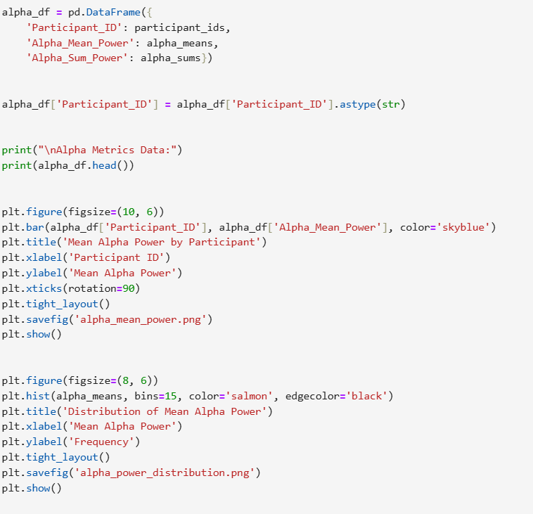
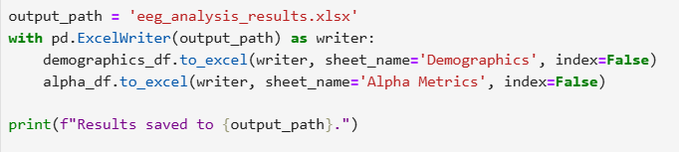
Results in graphs and excel file
Notes:
Why?: The alpha band (8–13 Hz) is the focus of analysis.
What it does:alpha_mask: A boolean array where True values indicate frequencies between 8 and 13 Hz.
alpha_freq: Extracts frequencies in the alpha range.
alpha_power: Extracts the power values corresponding to those frequencies.

Slide 6
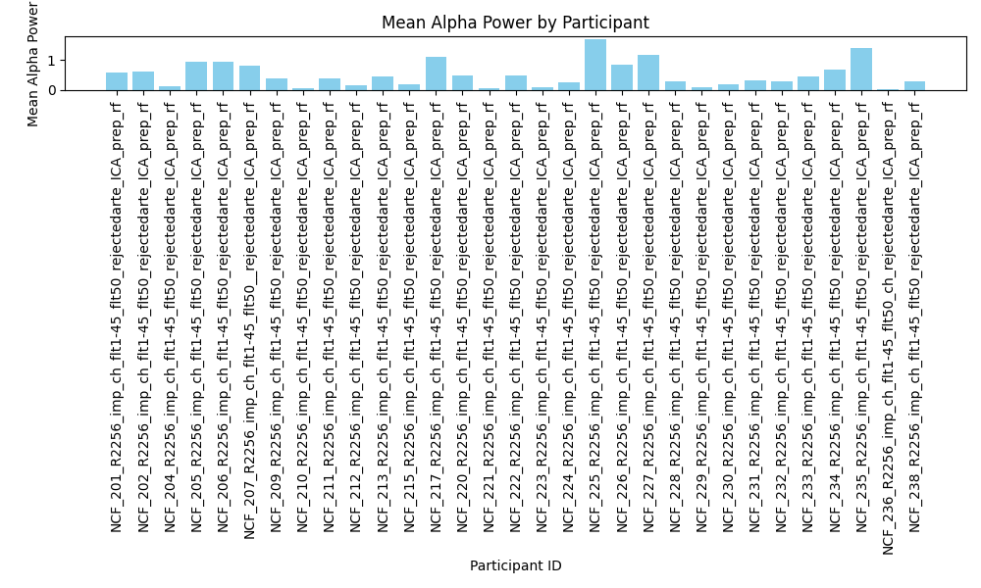
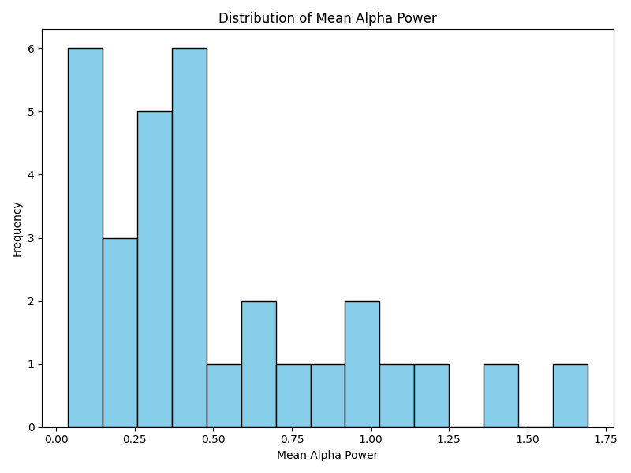

Slide 7
The next steps
To try extract frequencies and PSDs using only Phyton.
To plot the PSDs of all participants in one spectrum.
Try to extract 1/f slope from the data and store it in excel.

